Slide 1














































Lecture No 09

Slide 2


















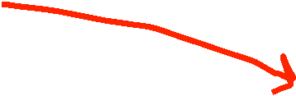




































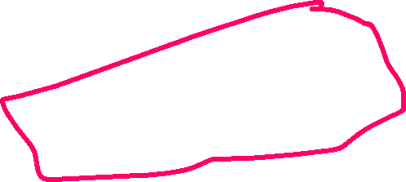


















Slide 3
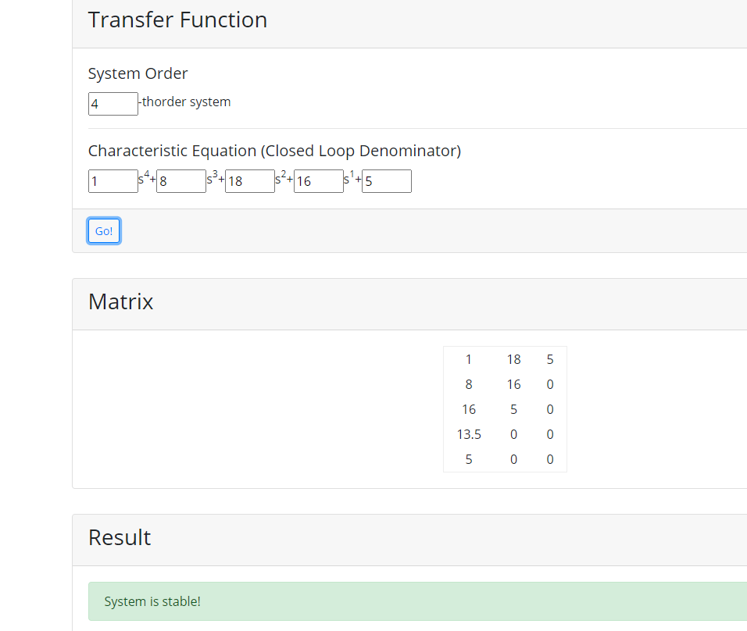



































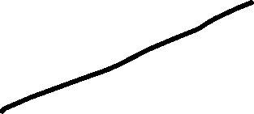












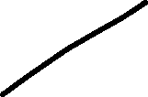


Apply the routh array, determine the stability of the system represented by the characteristics equation of S⁴ + 8S³ + 18S² + 16S + 5 = 0

Slide 4





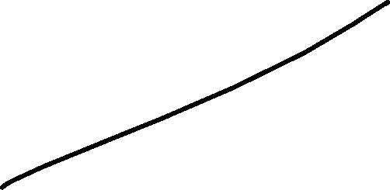















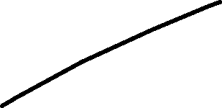


Slide 5











































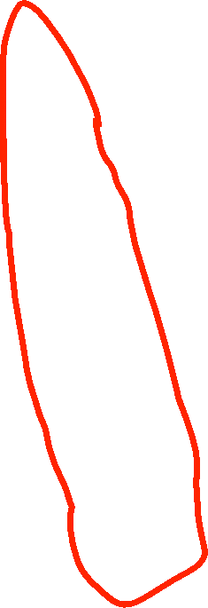








Slide 6

















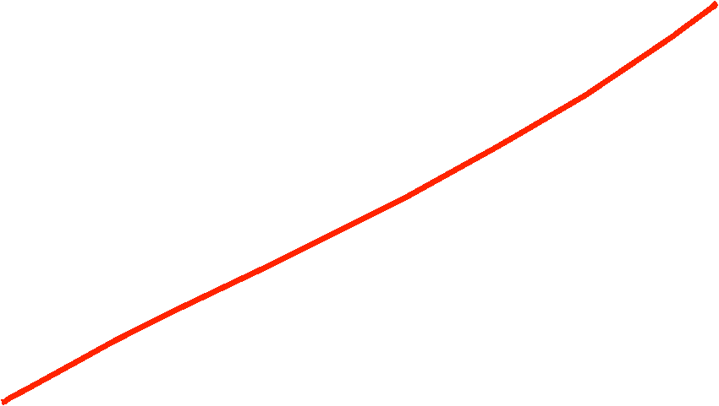











Slide 7








Sampling is the process of conversion of a continuous-time signal into a discrete time signal is known as Sampling.
OR
Sampling is the process of the reduction of a continuous-time signal into a discrete time signal is known as Sampling.

Slide 8



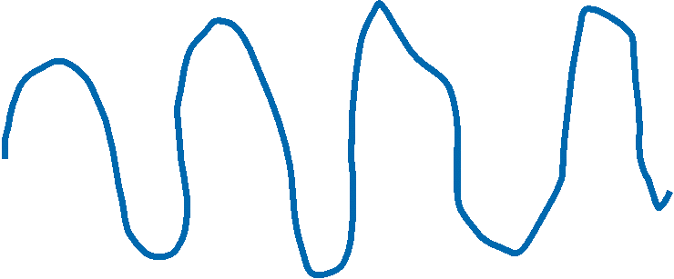








Slide 9
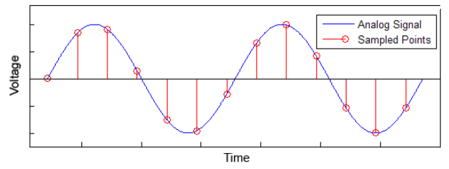
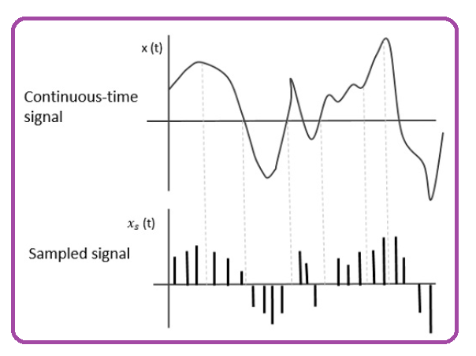
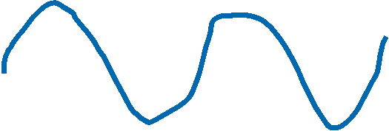







Slide 10


























Slide 11




















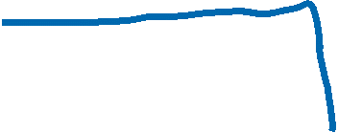











A Time Limited Signal is one that is nonzero only for a finite length of time interval is known as Time Limited Signal.

Slide 12

















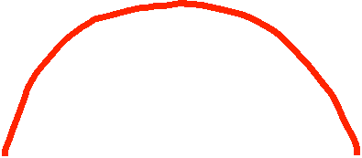






A Band Limited Signal is one type of signal, whose frequency response is limited or not equal to zero for a particular frequency band and for all other frequency values of signal is zero is known as Band Limited Signal.
OR
A Band Limited signal is a signal in which only some particular-band of frequencies are present is known as Band Limited Signal.
OR
A Band Limited Signal is one whose Fourier Transform is non-zero on only a finite interval of the frequency axis.

Slide 13
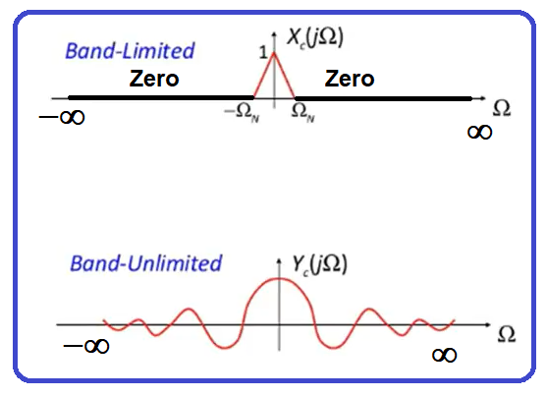
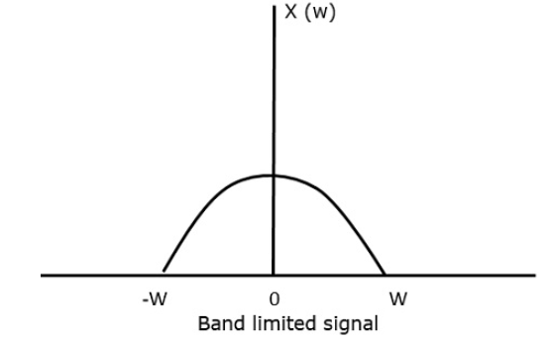








Slide 14
















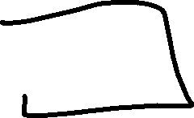









































Slide 15




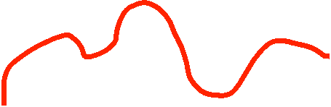






















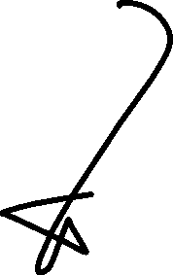

Sampling Theorem: A signal can be represented or reconstructed in its samples and can recover back when sampling frequency is greater or equal to twice the maximum frequency component present in the signal.

Slide 16
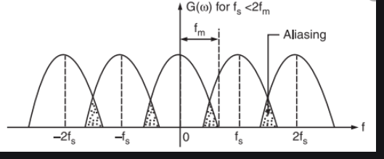
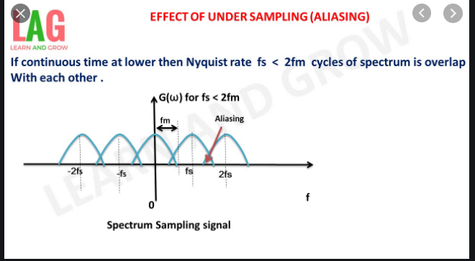









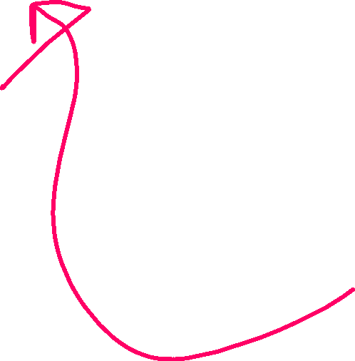













Slide 17
























































Sin100pt + cos200pit

Slide 18













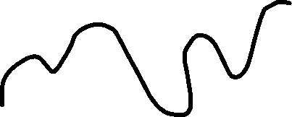














Slide 19

















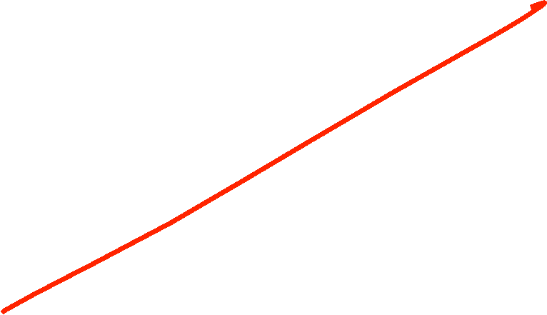












Slide 20




















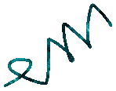


























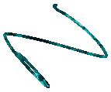























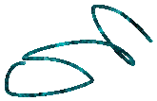

















Slide 21


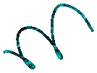










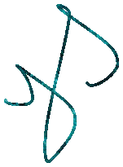










































Slide 22








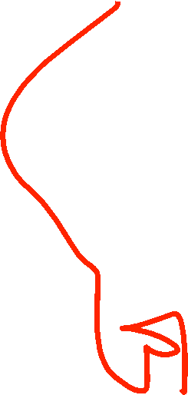


























For an invertible system, there should be one to one mapping between input and output each and every instant of time is known as Invertible system otherwise it is Non-invertible system

Slide 23









